Slide 1
GRAPH & GRAPH ALGORITHMS IMPLEMENTATION

Slide 2
KELOMPOK 21
Sakti Cahaya Buana (22/503237/TK/54974)
Deren Tanaphan (22/503261/TK/54976)
Sulaiman Fawwaz A.K (22/493813/TK/54120)

Slide 3








1
Adjacency Matrix
TABLE OF
2
Prim's Algorithm
CONTENTS
3
Kruskal's Algorithm
4
Algorithm Comparison

Slide 4







Adjacency
Matrix
Representing graphs using a 2-dimensional matrix.
Column and Row represent vertices.
Value of the matrix represent weight.

Slide 5
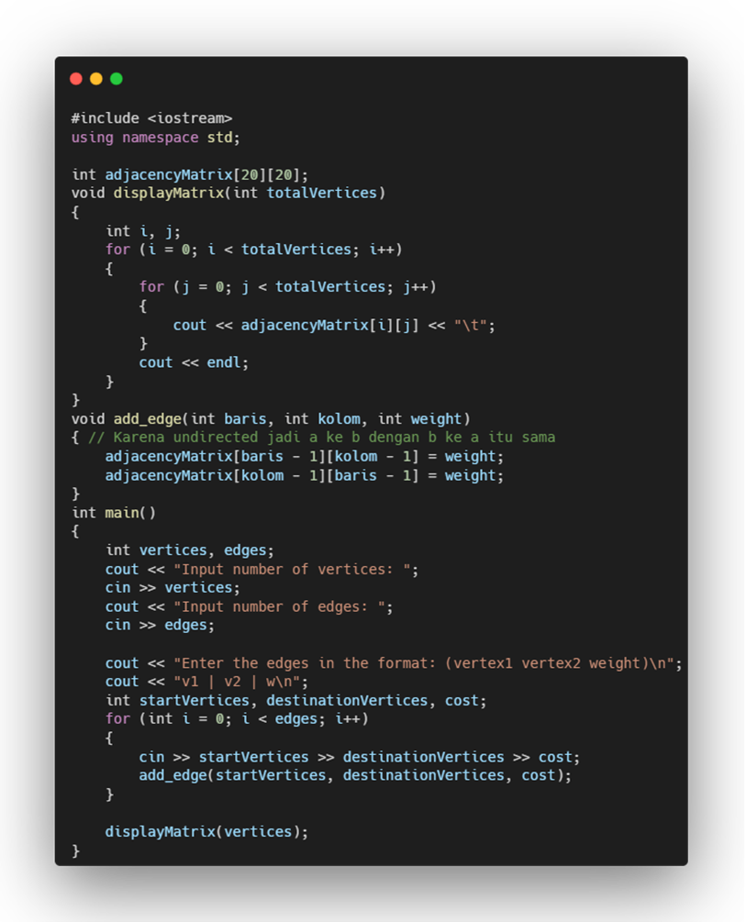
Function to display matrix
Function to add weight of edges into adjacency matrix.
Ask user to input total of vertices and edges
Ask user to define, which vertices are connected and their weight
Call function

Slide 6





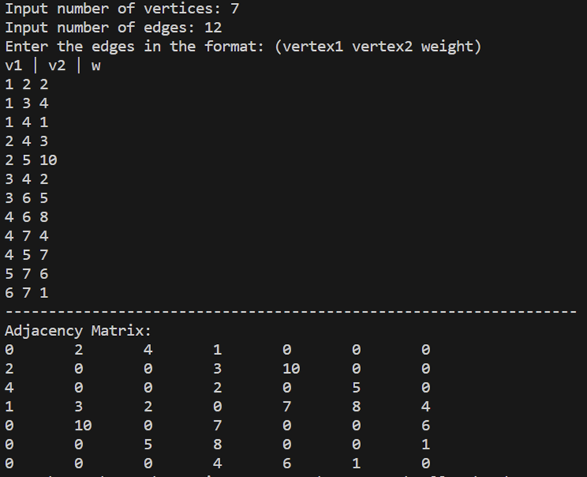


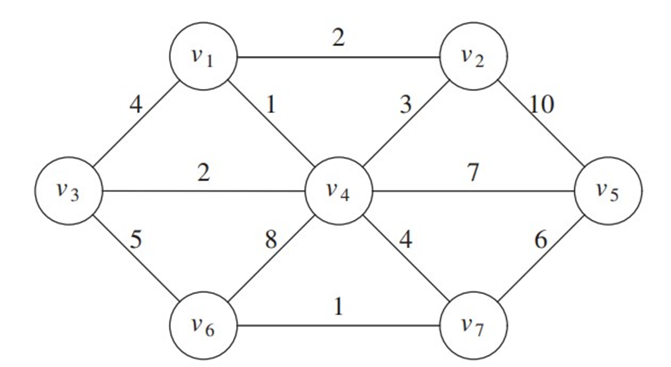
Example
AdjacencyMatrix

Slide 7

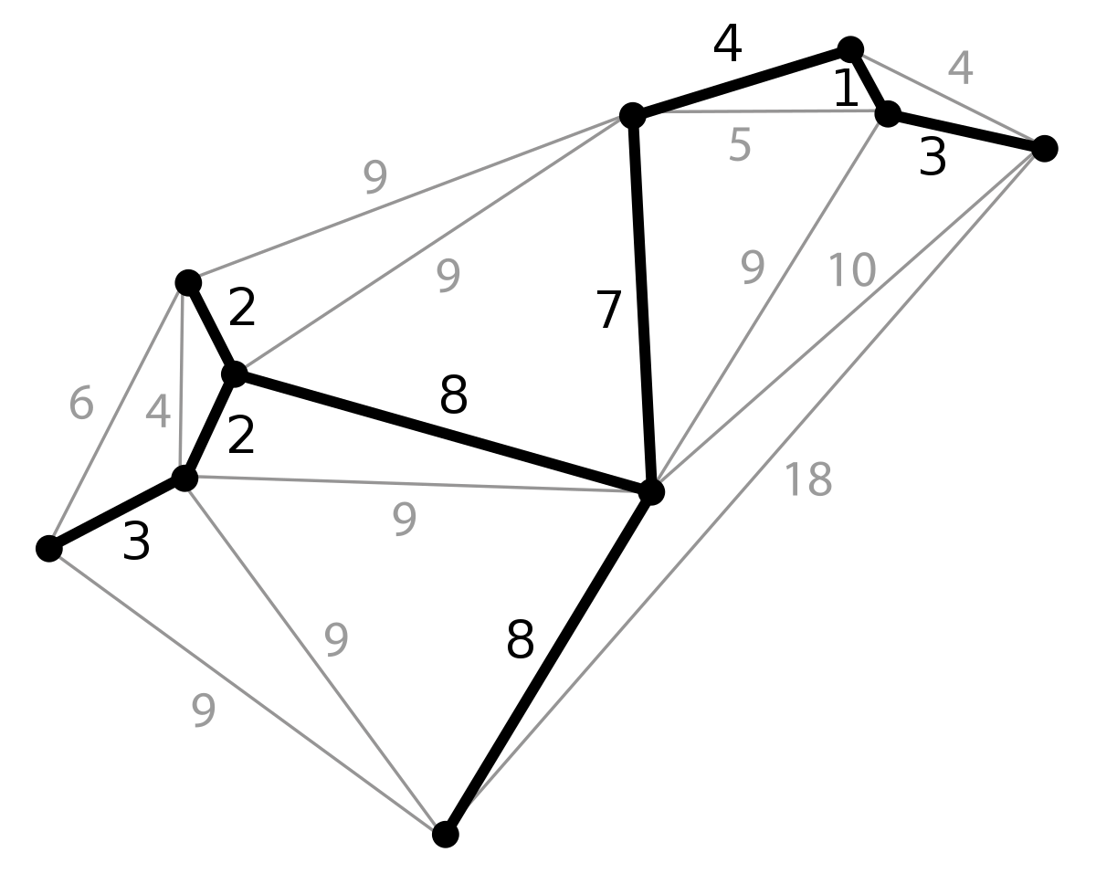



Kruskal's Algorithm
Implementation and explanation

Slide 8
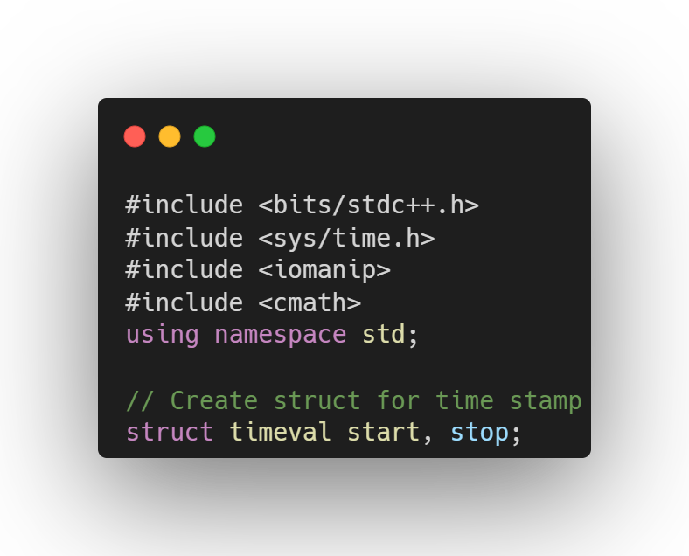
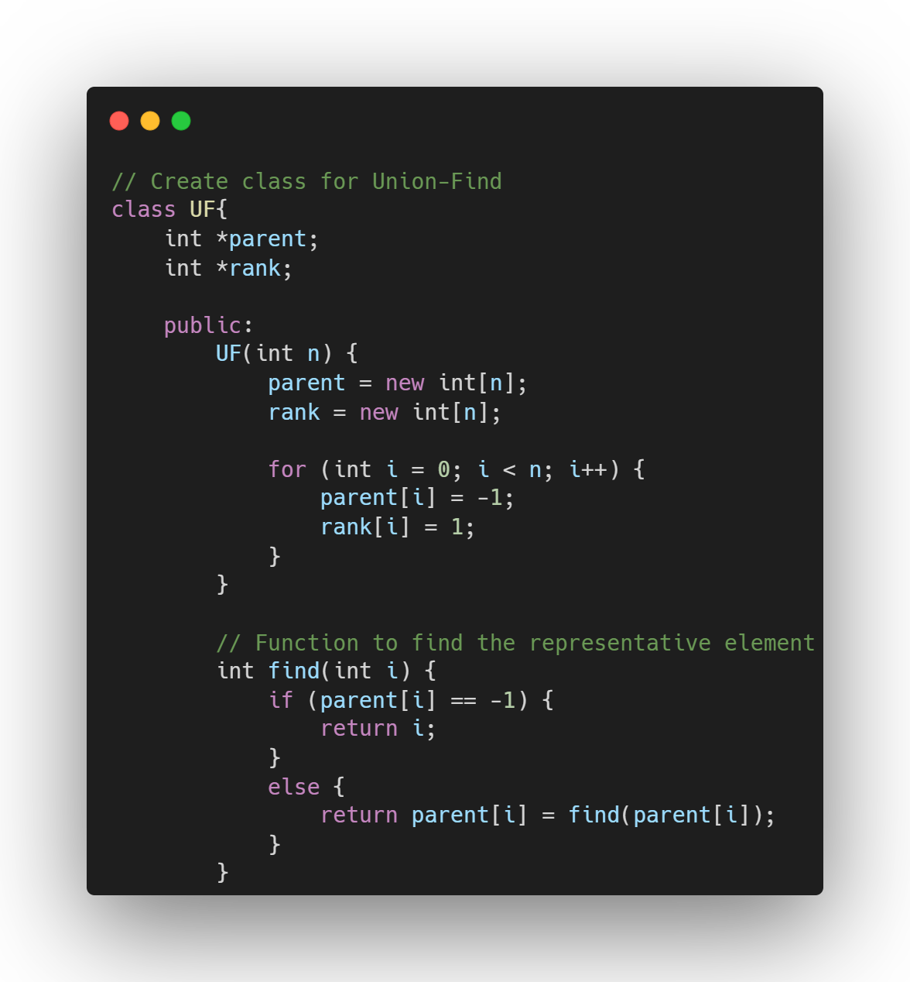
Code;
Make a class for Union-Find
Create a dynamically allocated array for parent and rank
Include all necessary header files
Initialize all parent and rank as -1 and 1
Create a function to find the representative element for each edges

Slide 9
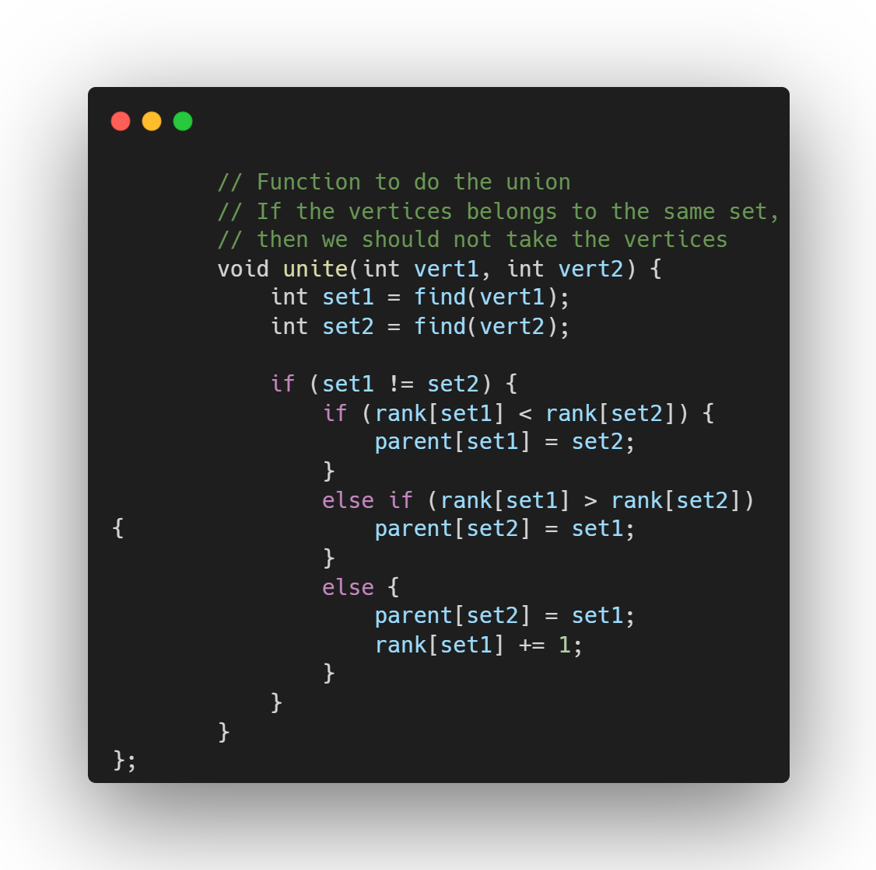
Make a function to unite the vertices
Find the representative element for the 1st & 2nd vertex
If the vertices have different representative element, i.e belongs to different sets, then we can unite them
If the vertices belong to the same set, than if we try to unite them a loop will encountered.
If the vertices belong to different sets, there will be no loop created

Slide 10
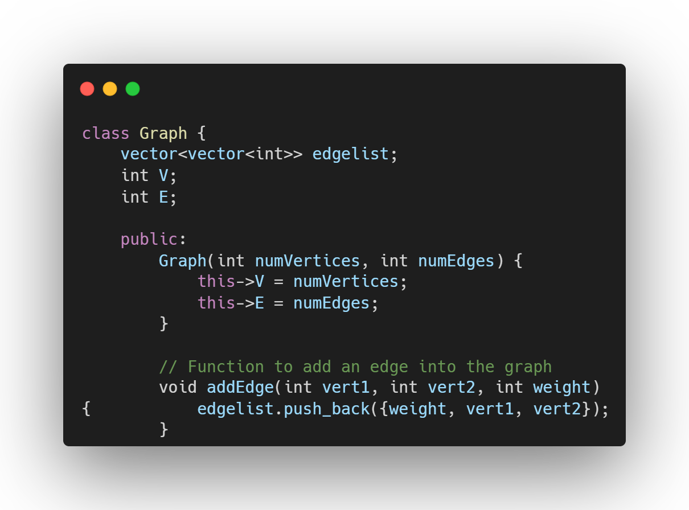
Make a class for the graph elements
Make a 2D vector edgelist, int V, and int E
Initialize the value of V and E by passing the arguments from the function
Make a function to add an edge. The argument consists of source and destination vertices, and the weight.

Slide 11
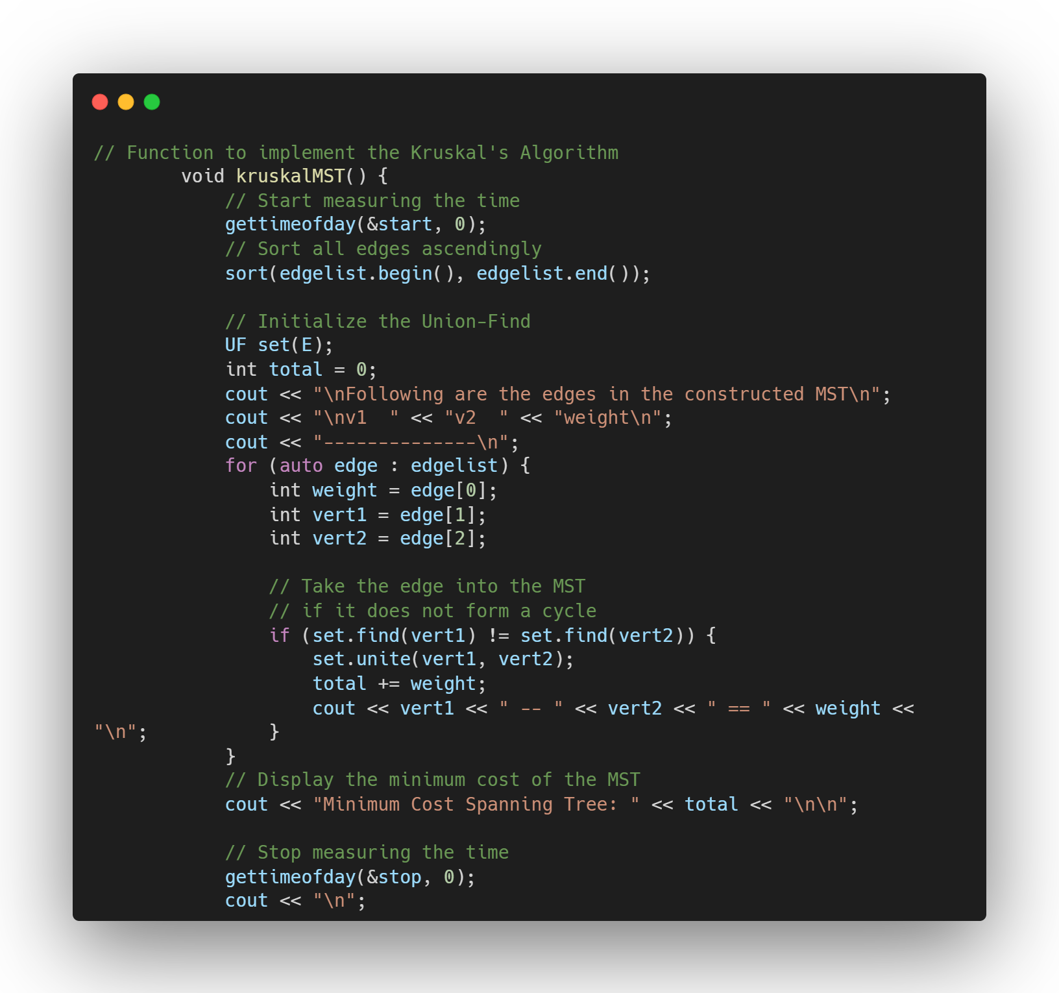
Make a function to implement the Kruskal’s Algorithm
Start measuring the time
Sort the edges ascendingly with sort() function
Initialize the total weight of the MST to 0
Iterate through all the edges
Initialize variables to contain the weight and the vertices according to the vector’s indices
Take the edge if the vertices don’t belong to the same set, i.e don’t make a loop
Sum up the total weight of the MST
Display the vertices, edge, and the weight
When the iteration is done, display the total weight of the created MST
Stop measuring the time

Slide 12
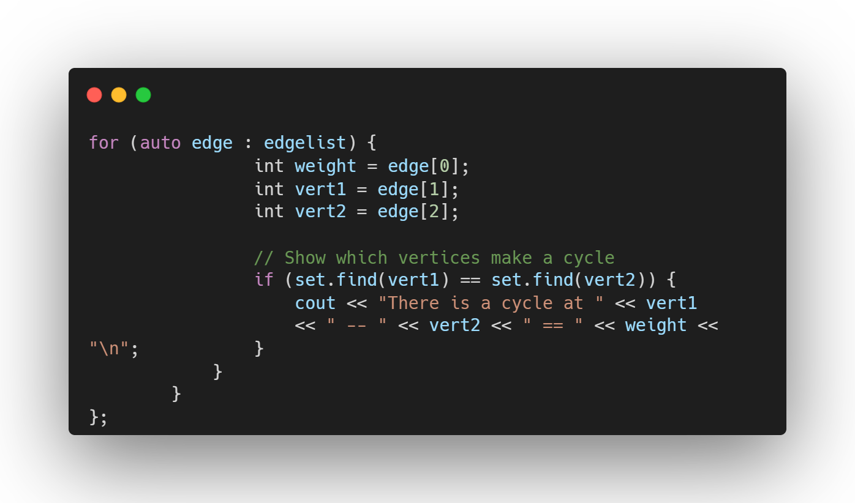
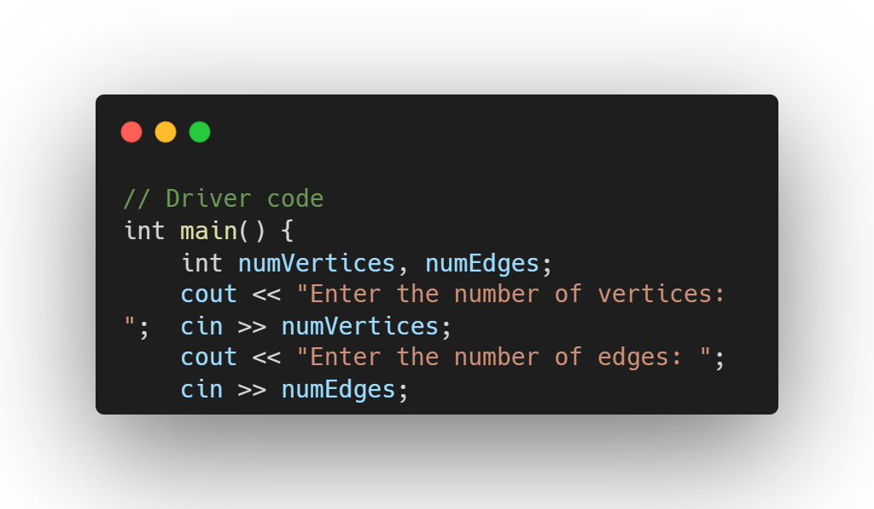
Iterate through all the edges
Initialize the weight, 1st & 2nd vertices according to the indices of the vector
Show all the edges that will make a loop, i.e the edges that are not taken into the MST
Declare the variable to hold the number of the vertices and edges
Take the user input for the number of vertices
Take the user input for the number of edges

Slide 13
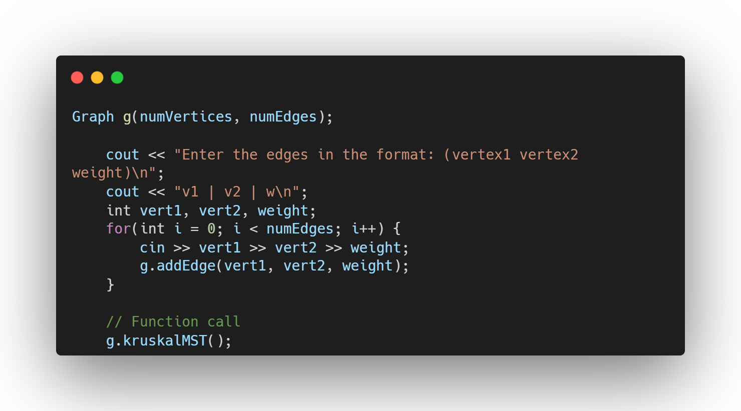
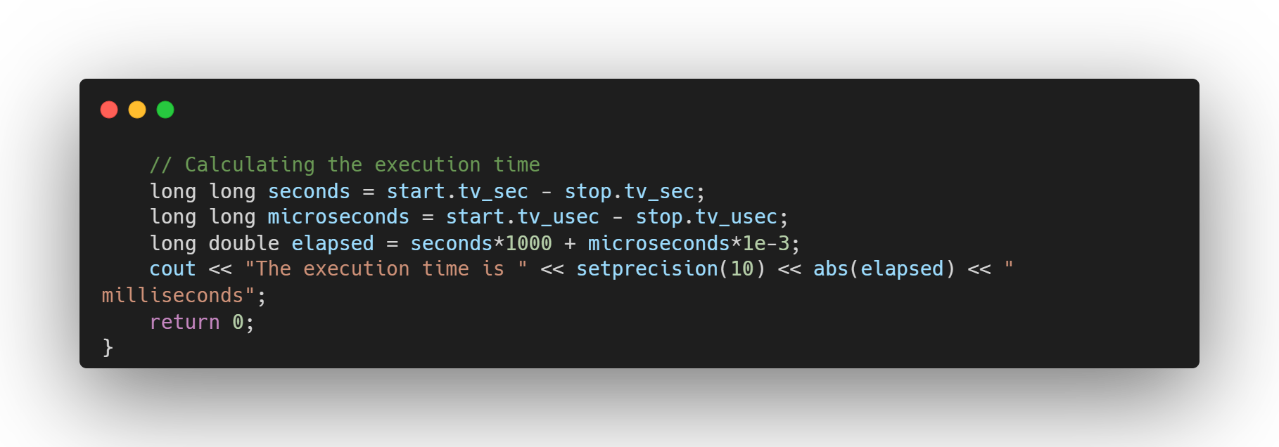
Make an object of the Graph class
Take the vertices and weight of the edges from the user in format like:
vert1 <space> vert2 <space> weight
Add the edges from the user input
Take the vertices and weight of the edges from the user in format like:
vert1 <space> vert2 <space> weight
Add the edges from the user input
Call the function to implement the Kruskal’s Algorithm
Calculate the recorded time for implementing the Kruskal’s Algorithm

Slide 14
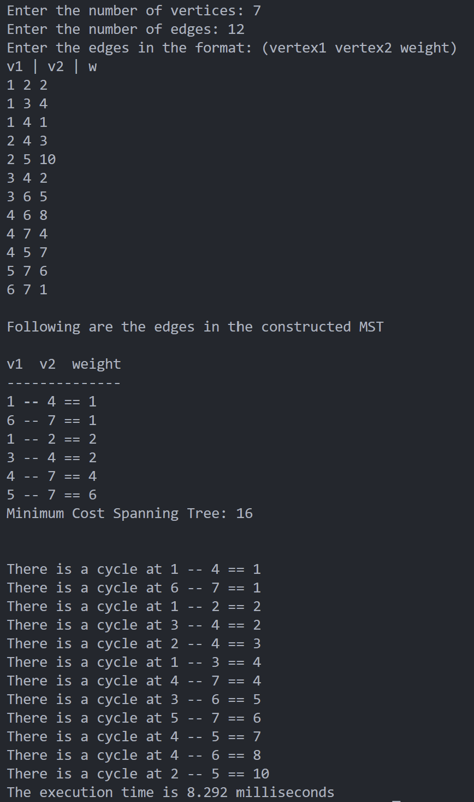
Output;
By using this input:
1 2 2
1 3 4
1 4 1
2 4 3
2 5 10
3 4 2
3 6 5
4 6 8
4 7 4
4 5 7
5 7 6
6 7 1
User input
The resulting MST
The edges that is not taken into the MST
Execution time

Slide 15
Adjacency
Matrix
Merepresentasikan graph ke dalam sebuah matriks.
Dalam program c++, matriks tersebut disimpan dalam array 2 dimensi

Slide 16
PRIM ALGORITHM

Slide 17


1
Prim's algorithm finds the minimum spanning tree (MST) of a weighted undirected graph by greedily adding the shortest edges.
PRIM'S
ALGORITHM?
2
The algorithm selects the minimum-weight edge at each step to connect explored and frontier vertices, gradually expanding the MST.
3
Prim's algorithm guarantees the construction of an MST and has a time complexity of O(V^2) or O(E log(V)), depending on the implementation.

Slide 18
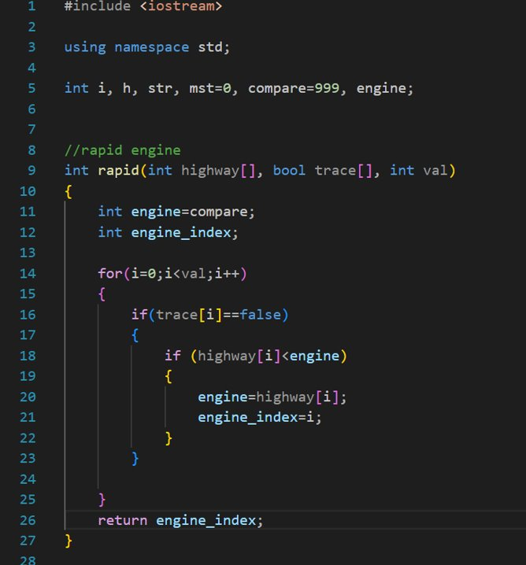
Global variables declaration
Finds the index of the vertex with the minimum edge weight among the unvisited vertices.

Slide 19
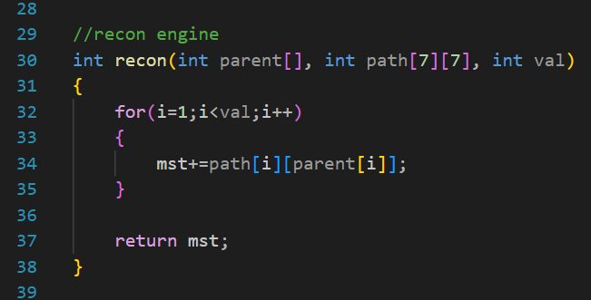
Calculates the total weight of the minimum spanning tree (MST) based on the selected parent vertices.

Slide 20
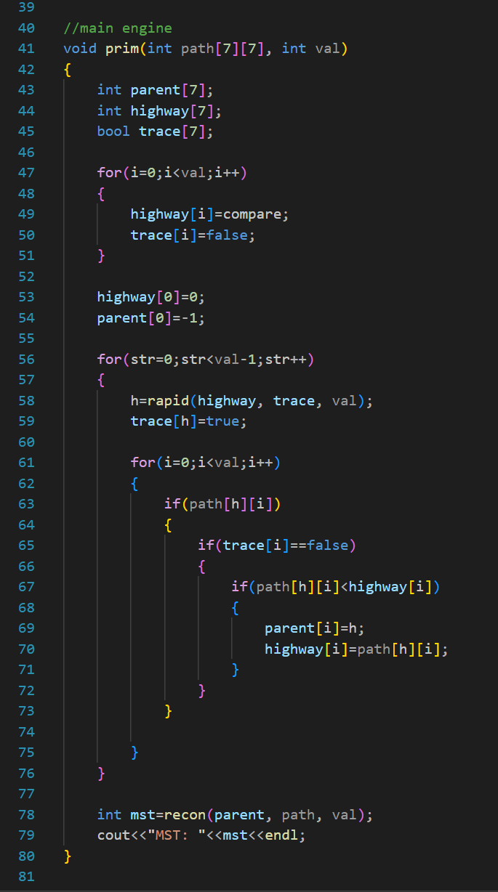
Calculates the total weight of the minimum spanning tree (MST) based on the selected parent vertices.

Slide 21
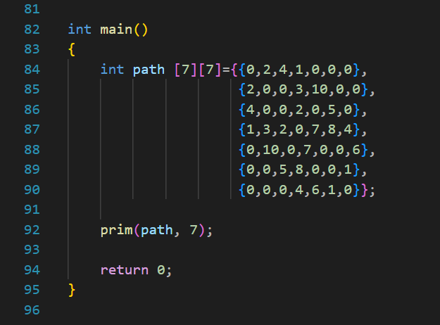
Entry point of the program that initializes the graph, calls the prim() function, and outputs the weight of the MST.

Slide 22
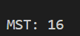
Output;​
This program will have the ouput MST (Minimum Spanning Tree), displaying the total weight of the shortest or lightest path chosen.

Slide 23
Algorithm Comparation;​
Approach | Kruskal | Prim
Algorithm Type | Greedy algorithm | Greedy Algorithm
Approach | Selects edges based on their weights and avoids cycles | Starts from an arbitrary vertex and adding the closest vertex
Graph Type | Works for connected and disconnected graphs | Works only for connected graph
Spanning Tree Growth | Grows the spanning tree by adding edges | Grows the spanning tree by adding vertices
Complexity | O(E log E) or O(E log V) | O(E log V) or O(V)
Average Execution Time (ms) | 5.4276 | 1.3988
The result is likely to be affected by the way of the algorithm’s implementation

Slide 24
Cont’d;
The result is likely to be affected by the way of the algorithm’s implementation

Slide 25





GitHub
https://github.com/deren21/Kruskal-and-Prim-Algorithm
Repository

Slide 26
THANK YOU

